Slide 1
Attendance Code:

Slide 2
OOP/SW – Week 8
Dr. Jizheng Wan
Nov 2023

Slide 3
Structure
Files concepts – Lecture 2
File handling classes – Lecture 2
Stream handling classes – Lecture 2
Random access files – Lecture 2

Slide 4
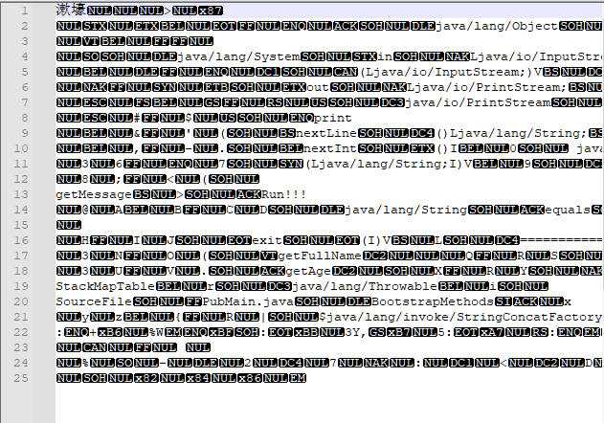
Files concepts
Computer files
Files are collections of data that exist on nonvolatile devices.
Based on how a file has been stored:
Text file:
  Data that can be read in a text editor
  Coded with ASC II or Unicode
    E.g. .java file.
Binary file:
  Data that has not been encoded as text
    E.g. Images, music and compiled java program with .class extension.

Slide 5
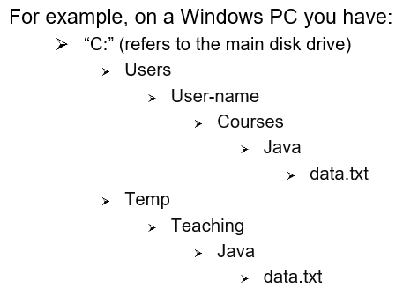
File folders
Path names
  E.g. “C:\Temp\Teaching\Java\data.txt”
  If you use a Unix-style file system, use forward-slash (/) instead of back-slash (\)
Relative path – Path relative to the current directory
  E.g., If the current directory is “C:\Temp\Teaching” then “Java\data.txt” is a relative path.
Absolute path – is the full path (i.e., non-relative path)

Slide 6
Java classes for File I/O
We will use two packages:
import java.io.*;
import java.nio.file.*; // nio stands for “new I/O”, added in Java 1.7
The classes you will need to use:
FileSystem – a bureaucratic class needed for the top level (but we can suppress it)
Path – class for file paths, as well as files themselves!
Paths (note the plural) – utility functions for paths
Files (note the plural) – file operations on paths, i.e., files
Is there a File class (without the plural)?
There is, but the Path class from the nio package can do all of its work.

Slide 7
File handling classes - Path
Operations on paths
Creating paths
Extracting components of paths
Extracting subpaths
Comparing paths (check if one is a subpath of another)
Converting relative paths to absolute paths.

Slide 8
File handling classes - Path
Path class
Used to create objects that contain information about files and directories:
  E.g. locations, sizes and create dates.
Creating a Path
First determine the default file system by using FileSystem.
Then define a Path using getPath(strPath) method
Use two black-slash instead of one, as the first black-slash is an escape char.
  Escape sequences are used to signal an alternative interpretation of a series of characters.
FileSystem fs = FileSystems.getDefault();
Path filePath = fs.getPath("E:\\wanjizheng\\OneDrive - University of Birmingham\\OOP" +
"\\2023\\Week8\\Code\\Lecture2\\src\\main\\resources\\Data.txt");

Slide 9
File handling classes - Path
Running on different OS?
Using fs.getSeparator()method to replace “\\”.
filePath = fs.getPath("E:"+fs.getSeparator()+"wanjizheng"+fs.getSeparator()+"OneDrive - University of Birmingham"+
fs.getSeparator()+"OOP"+fs.getSeparator()+"2023"+fs.getSeparator()+"Week8"+fs.getSeparator()+
"Code"+fs.getSeparator()+"Lecture2"+fs.getSeparator()+"src"+fs.getSeparator()+
"main"+fs.getSeparator()+"resources"+fs.getSeparator()+"Data.txt");

Slide 10
File handling classes - Path
Retrieving Path information
String toString()
  Returns String representation, eliminating double backsplashes.
Path getFileName()
  Returns file or directory denoted by this Path.
Int getNameCount()
  Returns number of name elements in the Path.
Path getName(int)
  Returns name in the position of the Path specified by the integer parameter.
Code: fileMain.java

Slide 11
File handling classes - Path
Getting path of the “resources” folder.
ClassLoader.getResource(fileName);
ClassLoader classLoader = FileMain.class.getClassLoader();
URL resource = classLoader.getResource("Data.txt");
filePath = Paths.get(resource.toURI());

Slide 12
File handling classes - Path
Determine Basic File attributes
readAttributes() method
  Path object and BasicFileAttributes.class.
creationTime() and lastModifiedTime()
Owner Attribute
getFileAttributeView() method
  Path object and FileOwnerAttributeView.class.

Slide 13
File handling classes - File
File class
An abstract representation of file and directory pathnames.
Creating a File object
new File(filePath.toUri());

Slide 14
File handling classes - File
Commonly used methods
Method | Description
exists() | Tests whether the file or directory denoted by this abstract pathname exists.
isFile() isDirectory() | Tests whether the file denoted by this abstract pathname is a file/directory.
canRead() canWrite() canExecute() | Tests whether the application is allowed to read/write/execute to the file
setReadable() setWritable() setExecutable() | Sets the access permission to allow read/write/execute operations;
createNewFile() | Creates a new, empty file named by this abstract pathname if and only if a file with this name does not yet exist.
mkdir() mkdirs() | Creates the directory named by this abstract pathname. Including any necessary but nonexistent parent directories.
delete() | Deletes the file or directory denoted by this abstract pathname.
length() | Returns the length of the file
Useful methods:

Slide 15
Activity: Knowledge Check
A binary file contains ___________.
a. Only two items
b. Data items that have not been encoded as text
c. Volatile storage
d. Facts and figures
Answer: b. Data items that have not been encoded as text.

Slide 16
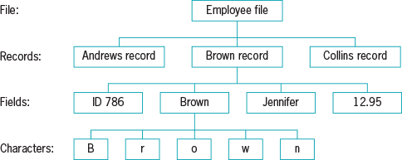
Stream handling classes – Data Hierarchy
  Collection of fields that contain data about an entity
  Group of characters with some meaning
Smallest useful piece of data to most users
Binary representation:
01000010

Slide 17

Stream handling classes
Stream
Java does not automatically attribute such meaning to a file’s content, and will simply view it as a series of bytes.
Stream is an object to perform actions such as opening, closing, reading and writing.
Most streams flow in only one direction:
  In an input stream
    “has next” method to check if any more data is present.
    “next” method that gives you the next piece of data.
  In an output stream
    “write” method to output a data element on the stream.

Slide 18
Stream handling classes
InputStream / OutputStream
  Meant for reading or writing bytes (8-bit memory units)
Reader / Writer
  Meant for reading or writing characters (in any supported character set)
Scanner / PrintWriter / PrintStream
  Meant for reading or writing strings
DataInputStream / DataOutputStream
  Meant for reading or writing data values (int, float, char, boolean etc.)
ObjectInputStream / ObjectOutputStream
  Meant for reading or writing entire objects (of Java classes)
  These classes need to implement serializable interface.

Slide 19
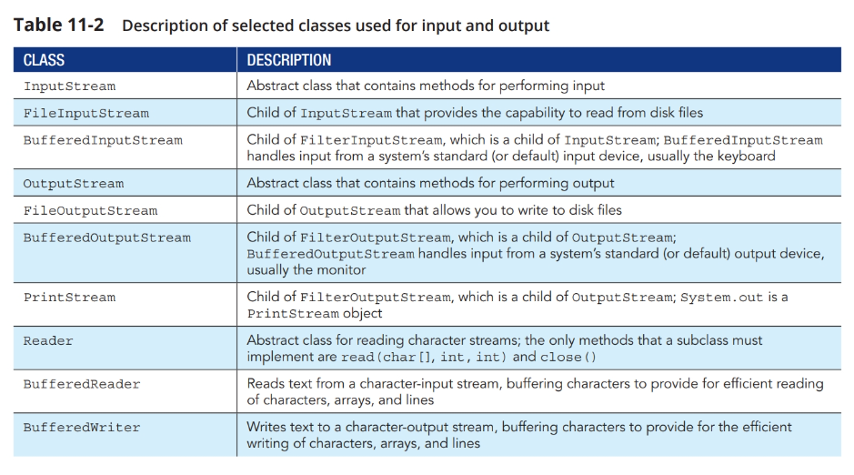
Stream handling classes

Slide 20
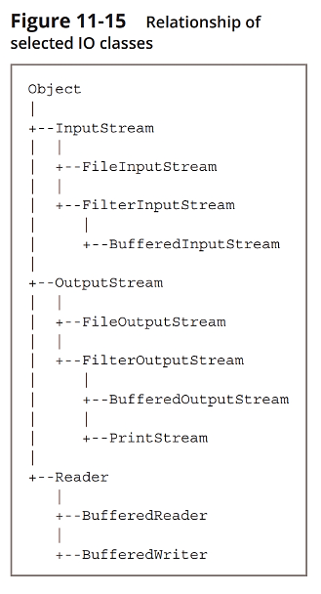
Stream handling classes
FileInputStream/FileOutputStream
Read/Write a byte (8-bits) at a time.
Work with raw binary data, such as images or audio files.
Slower for text files, because of looping through a byte at a time.
Code: FileMain.FileInputOutputExample()

Slide 21
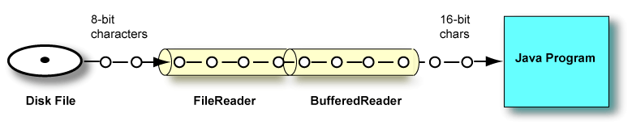
Java’s IO Classes
FileReader
A general tool to read in characters from a file.
Specifically designed to deal with the text files.
BufferedReader
Can wrap around Readers (e.g. FileReader) to buffer the input and improve efficiency.

Slide 22
The idea of “buffers”
A buffer allows programs or devices to communicate data to one another.
A put operation writes a new value into the buffer at position and advances it. The limit is set to the final value of position. (“relative put”)
A get operation reads the value at position and advances it. When it reaches limit, the ‘getting’ is finished. (“relative get”)
position
limit

Slide 23
The idea of “buffers”
That means, position is the place where the next read or write into the buffer should happen.
Simlarly, limit is the place from which buffer contains no valid data.
position
limit

Slide 24
The idea of “buffers”
A Buffer in Java adds two more indices into a sequence. (The sequence itself is not part of the Buffer; only the indices.)
In addition to get and put, some more operations are relevant:
  clear: Needed at the start of a channel read. Also, the start of a put cycle.
  Sets the position to 0 and limit to the capacity.
  flip: Needed at the start of a channel write. Also, the start of a get cycle.
  Sets the limit to the current position, and position to 0.
  rewind: Needed at the start of renewed get cycle.
  Sets the position to 0, leaves limit unchanged.

Slide 25
Java’s IO Classes
BufferedReader
Use the FileReader object to read the data from the file.
FileReader reads 2 (or 4) bytes at a time and returns the data to the BufferedReader.
Keep doing that until it hits ‘\n’ or ‘\r\n’ (the end of the line symbol).
The difference is that BufferedReader create a buffer of data before processing.
Hence it makes the process run much faster than doing 2 bytes a time.
Code: FileMain2.BufferedReaderExample()

Slide 26
Java’s IO Classes
BufferedReader methods:
close(): closes the stream and its resources.
read(): reads a character
readLine(): reads a line
skip(long n): skips specified number of characters.
Code: FileMain2.ReadEmployee()

Slide 27
Java’s IO Classes
BufferedWriter:
Similar to the BufferedReader, you can use the writer class to write data into a file.
Code: FileMain2. WriteEmployee()

Slide 28
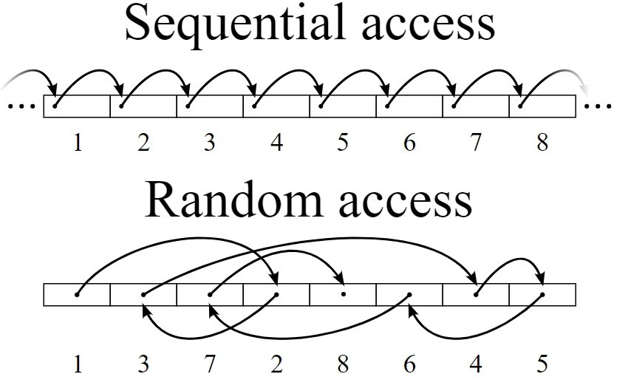
Random access files
Sequential access file
Each record is accessed in the order in which it was stored
Random access file
A file in which records can be accessed or retrieved directly in any order.
Behaves like a large array of bytes.
File pointer, a kind of index into the implied array.
Input operations read bytes starting at the file pointer and advance the file pointer past the bytes read.

Slide 29
Random access files
File channel object
  Avenue for reading and writing a file
  FileChannel class used to create a random access file
  Wrapped
  An array of bytes encompassed into a ByteBuffer
  Holding place for bytes waiting to be read or written
Code:
RandomAccessTest
FileMain2. WriteRandomAccessEmployee()

Slide 30
Activity: Knowledge Check
A(n) ___________ program is one in which the user makes direct requests.
a. sequential
b. front-end
c. volatile
d. interactive

Slide 31
Activity: Knowledge Check
A(n) ___________ program is one in which the user makes direct requests.
a. sequential
b. front-end
c. volatile
d. interactive
Answer: d. interactive A program in which the user makes direct requests is an interactive program. For example, if a customer telephones a department store with a question about a monthly bill, the customer service rep requires a random access file, in which records can be accessed or retrieved directly in any order.

Slide 32

Q & A

